Slide 1

ELECTRICAL & ELECTRONICS ENGINEERING DEPARTMENT
# CHAITANYA BHARATHI INSTITUTE OF TECHNOLOGY #
Seminar on:
UNDERWATER WINDMILL
Author(s): OP KEDAR
Source: [
Presented by
Name: R.Yeshwanth
Roll No: 160117734120

Slide 2
Contents
Renewable Energy
Name Justification
Underwater Windmill
History
Main Parts
Principle of Operation
Types of Underwater Windmills
Advantages
Limitations
Conclusions
References

Slide 3
RENEWABLE ENERGY
Renewable energy sources have major role in decreasing of emissions of the carbon dioxide into atmosphere.
Increased proportion of renewable energy sources enhance energetic viability of the energy system. It also helps to enhance energy delivery security by decreasing dependency on importing energetic raw materials and electrical energy.
Renewable energy is the energy which comes from natural resources such as sunlight, wind, tides, and geothermal heat, etc,. which are renewable (naturally replenished).

Slide 4
RENEWABLE SOURCES OF ENERGY
Solar Energy
Tidal Energy
Wind Energy
Hydro Energy
Geothermal Energy

Slide 5
technology
Wave energy converters
Tidal/currents
Ocean thermal energy conversion [otec]
Offshore wind

Slide 6
Name justification
Why is it called “underwater windmill”?
“Basically, it’s like putting a windmill in the water”.
Or as it’s looking like a windmill and are installed on the ocean floor and large river bed, that means these are under the water.

Slide 7
Underwater windmill
An underwater windmill is like a device that extracts power from the tides. Renewable energy technologies are becoming an increasingly favourable alternative to conventional energy sources to assuage fossil fuel related issues. Tidal energy offers a vast and reliable energy source.
This technology is similar to wind energy technology, with this rotor blades driven not by wind power but by tidal currents.
The gravitational pull of the moon produces a shift in tidal currents, which spins the long blades of the turbine. Which in turn produces electricity via different parts of underwater windmill.

Slide 8
history
Until late nineteen century windmills would only produce mechanical power of their tasks such as granting or plumbing water.
With the creation of electricity, windmills make found that windmills could be attaches to generator and used to create power.
The first windmill used to produce electrical energy was created in 1888 by Charles f brush.

Slide 10
Yaw system
generator
Yaw system adjust the orientation of the wind turbine into the wind direction
Roller yaw bearing system
Gliding yaw bearing system
Induction generator
Ac generators are commonly used
Permanent magnet synchronous generators
Field excited synchronous generator
Induction generator

Slide 11
Pitch system
gearbox
Blade twisting mechanism
Pitch reduces the impact of heavy wind
Most critical safety system
Pitch finding the right angle of the blade in right wind condition
Spur gearbox
Speed control
high gear ratios
High torque output
compact

Slide 12
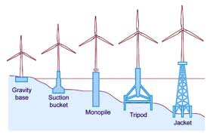
Structure concepts
Support structure
cables
Submarine power cables
Hvdc and hvac
High voltage direct current
High voltage alternating current

Slide 13
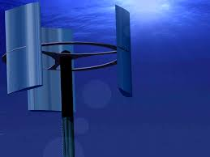
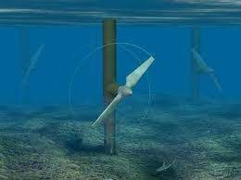
Types of underwater windmill
Vertical axis mill
Horizontal axis mill
The rotor direction is perpendicular to the direction of flow of water
The rotor shaft is horizontal to the direction of flow of water

Slide 14
Principle of operation
In simple an underwater windmill consists of a number of blades mounted on a hub (together known as the rotor), a gearbox and a generator.
The hydrodynamic effect of the flowing water past the blades causes the rotor to rotate, thus turning the generator to which the rotor is connected via a gearbox.
The gearbox is used to convert the rotational speed of the rotor shaft to the desired output speed of the generator shaft.
The electricity generated is transmitted to land through cables.

Slide 15
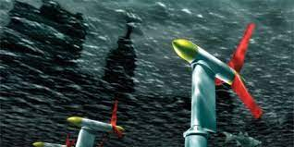
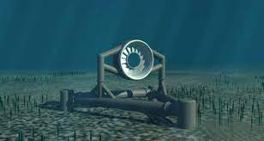
Turbines placed under water
Turbines running under water without harming the water animals
Turbine placed underwater to consume ocean power.

Slide 16
ADVANTAGES
Tidal energy is completely renewable
Tidal energy produces completely no emissions
Hidden beneath the water
Have lesser impact on the environment
Low running cost
Long lifetime with little maintenance
Reduces the dependence upon fossil fuels

Slide 17
Disadvantages
The initial cost is too high
Very difficult to install
The blade must be coated to avoid corrosion
Damages habitat up to 500 meters away
Maintenance is difficult

Slide 18
Conclusion
We believe that the intense and predictable marine current resource offers the possibility of clean energy at a cost that will ultimately be competitive not only with the other renewable, but in the long run we believe we can complete head on with most forms of fossil fuelled power generation at present-day costs.

Slide 19
References

Slide 21
THANK YOU

